Slide 2


Embrace Office 365 Groups: What's New and What's Next
#ADM51
Mike McLean
Principal Program Manager
Office 365 Groups
mmclean@Microsoft.com | @ @mikemcleanlive

Slide 3
Agenda
Office 365 Groups
Membership Service
End User
Innovation
Admin
Innovation
Roadmap
#ADM51

Slide 4
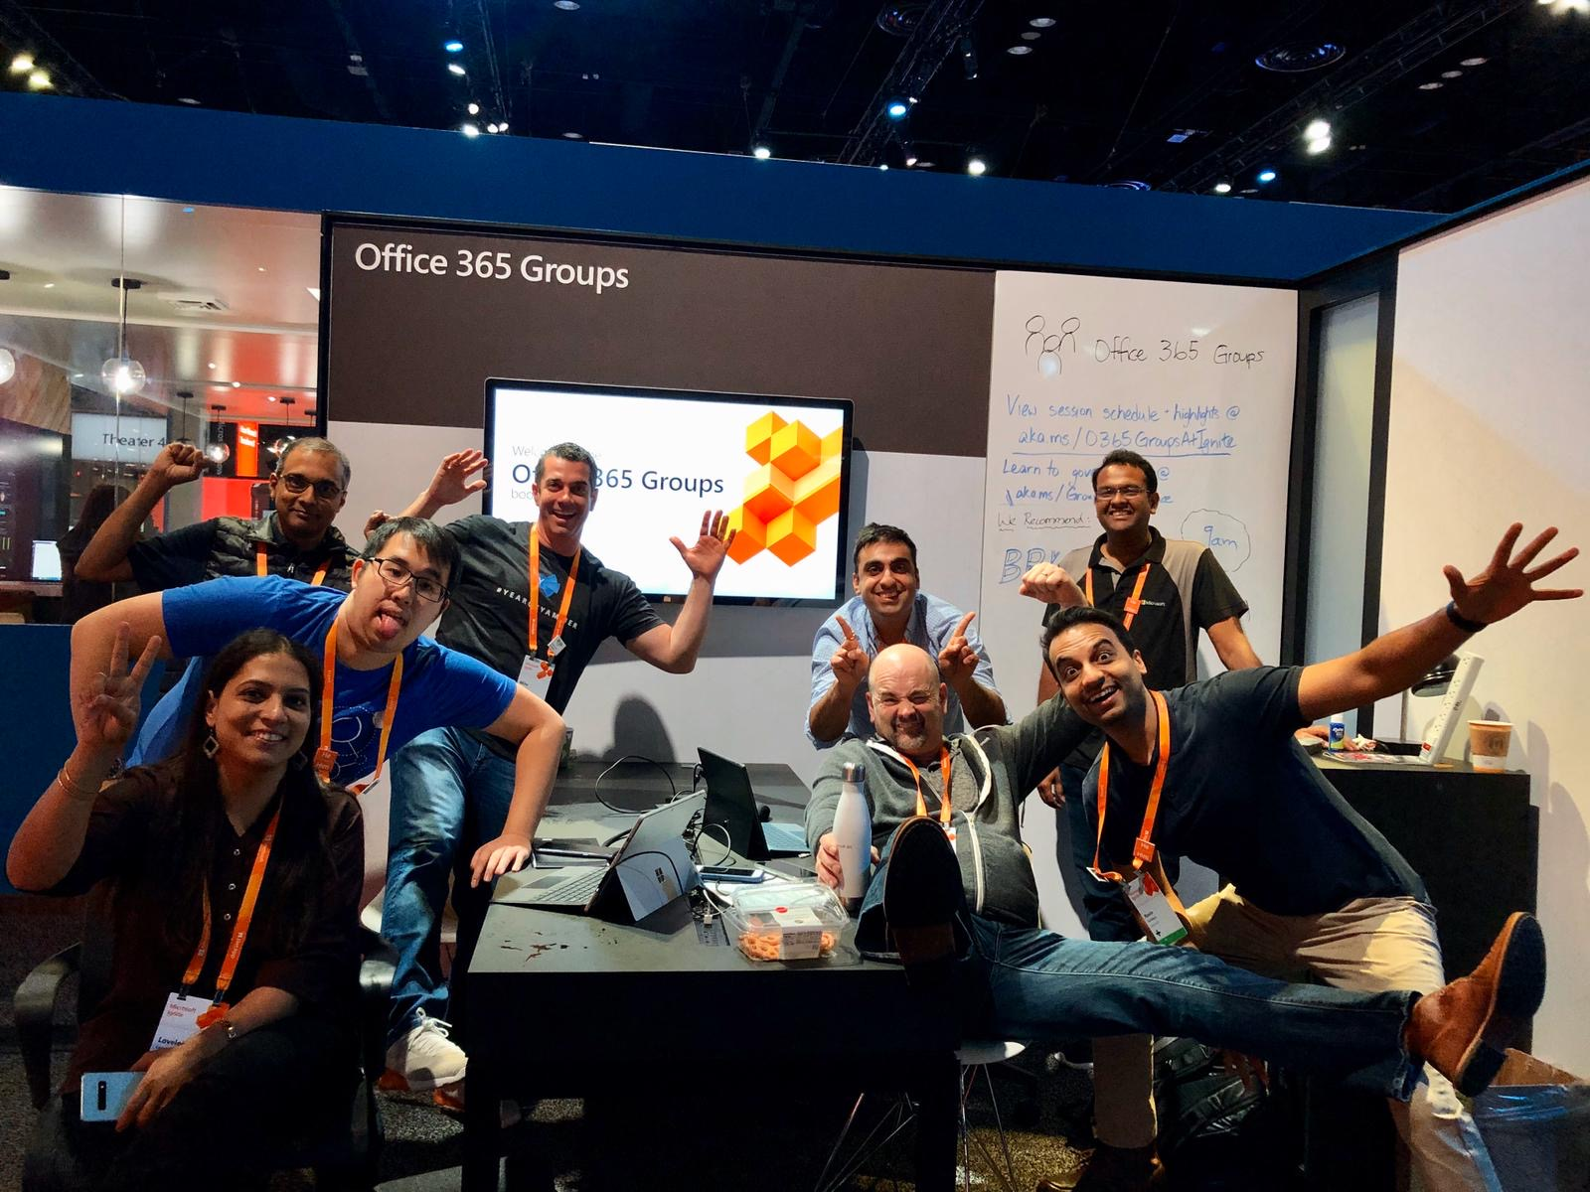
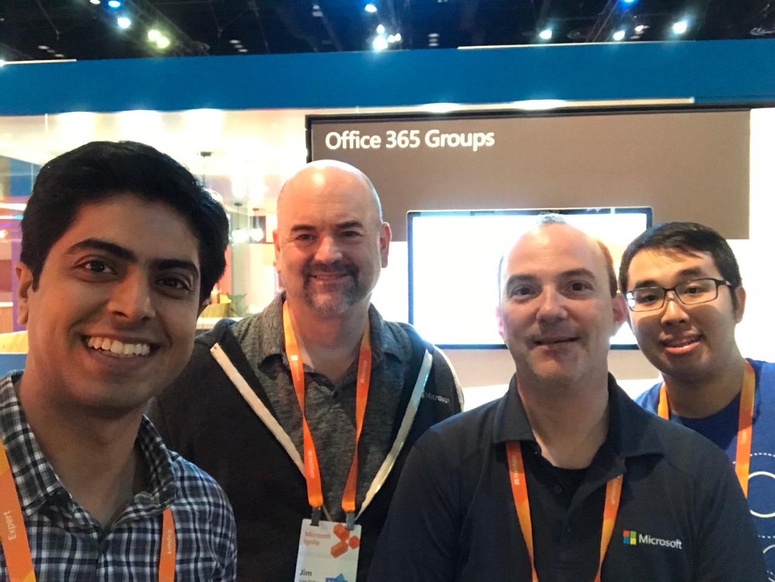
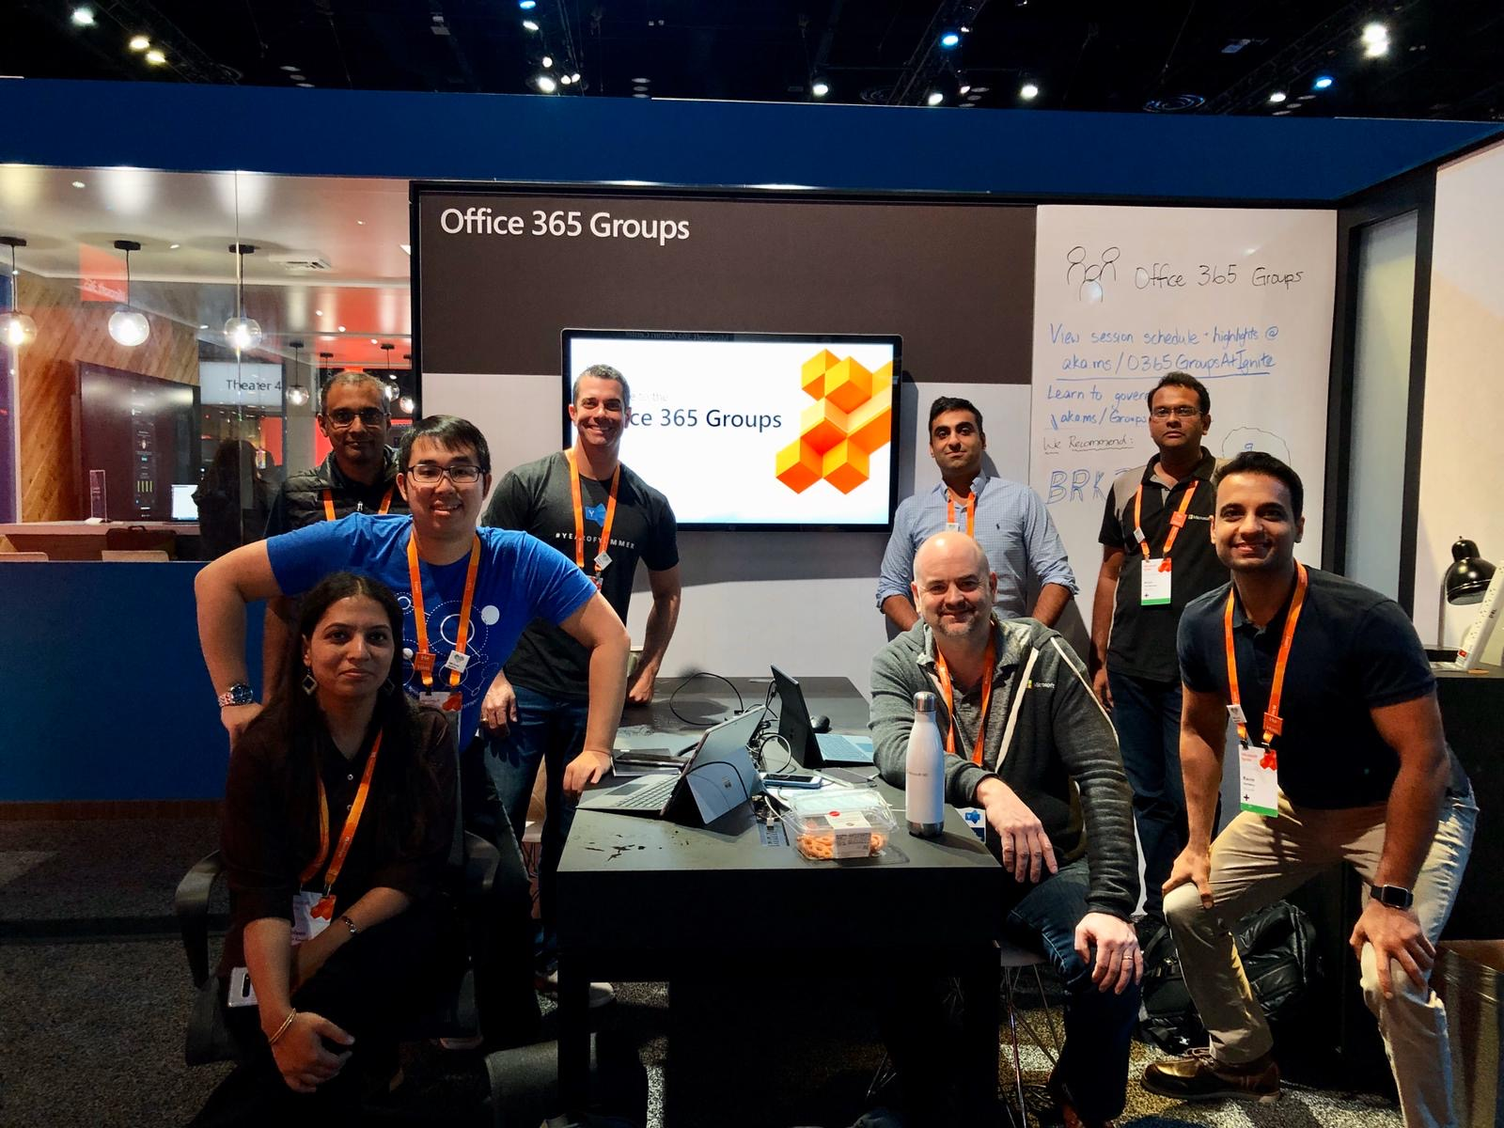
Groups Team says “Hi!”

Slide 5
Office 365 Groups Sessions @ Ignite
Recordings Available!
Breakout sessions
Monday: BRK2056 - Embrace Office 365 Groups: What's new and what's next (4:30 – 5:15)
Tuesday: ADM20 - Addressing top management issues with users and groups (10:15 – 11:00)
Wednesday: BRK2210 - Finding your collaboration sweet spot with Office 365 Groups, SharePoint, Teams, and Yammer (3:15 – 4:00)
Thursday: BRK3264 - Transform collaboration and fight shadow IT with Office 365 groups (10:15 – 11:00)
Friday: BRK2058 - Deploy Office 365 groups at scale to power Microsoft Teams, Outlook, Yammer, and SharePoint (9:00 – 9:45)
Theater sessions
Tuesday: THR3083 - Office 365 Groups: Ask us anything (12:40 – 1:00)
Wednesday: THR2091 - Master sharing and permissions of Office 365 in 20 minutes (2:30 – 2:50)
Wednesday: THR3043 - Microsoft Teams and Office 365 Groups PowerShell MasterClass (3:40 – 4:00)
Related sessions
Monday: THR2251 - How Microsoft empowers employees through self-service collaboration while still protecting the company in Office 365 (1:40 – 2:00)
Tuesday: BRK2233 - The future of Yammer: Share knowledge, engage leaders, and build communities in Microsoft 365 (9:00 – 10:15)
Wednesday: BRK2052 - What's new and what's next: SharePoint and OneDrive administration (12:45 – 1:30)
Notes:
Watch the recordings of all the sessions online on Microsoft TechCommunity.

Slide 6
Office 365 Groups Membership Service

Slide 7

Office 365 Groups Powering Collaboration Across Microsoft 365
Share knowledge and information using email, calendaring, documents and more
Streamline the creation and use of collaboration features
Enable communications in a secure and controlled manner
Leverage self-service capabilities to reduce costs and save time
Notes:
At the core, O365 Groups is a platform that powers collaboration experiences in M365. Whether it’s a team in Teams or a Community in Yammer or an Outlook Group, the O365 Groups platform enables users to create, share and discover knowledge and information.
Its quick and easy for a user to bring a group of people together under a unique identity and provision all the resources and assets needed to be productive. O365 Groups Platform also enables users to manage their groups within the boundaries set by IT and Admins.

Slide 8
Groups by the numbers…
107%
Annual increase in usage across Groups platform
1,000
Distribution Lists upgraded to Office 365 Groups each week
9M
Guests provisioned through Office 365 Groups
8X
Reduction in group creation latency
21→2hrs
Improved in response time using Actionable Emails
60%
Groups renewal during Expiry Autorenewal Private Preview

Slide 9







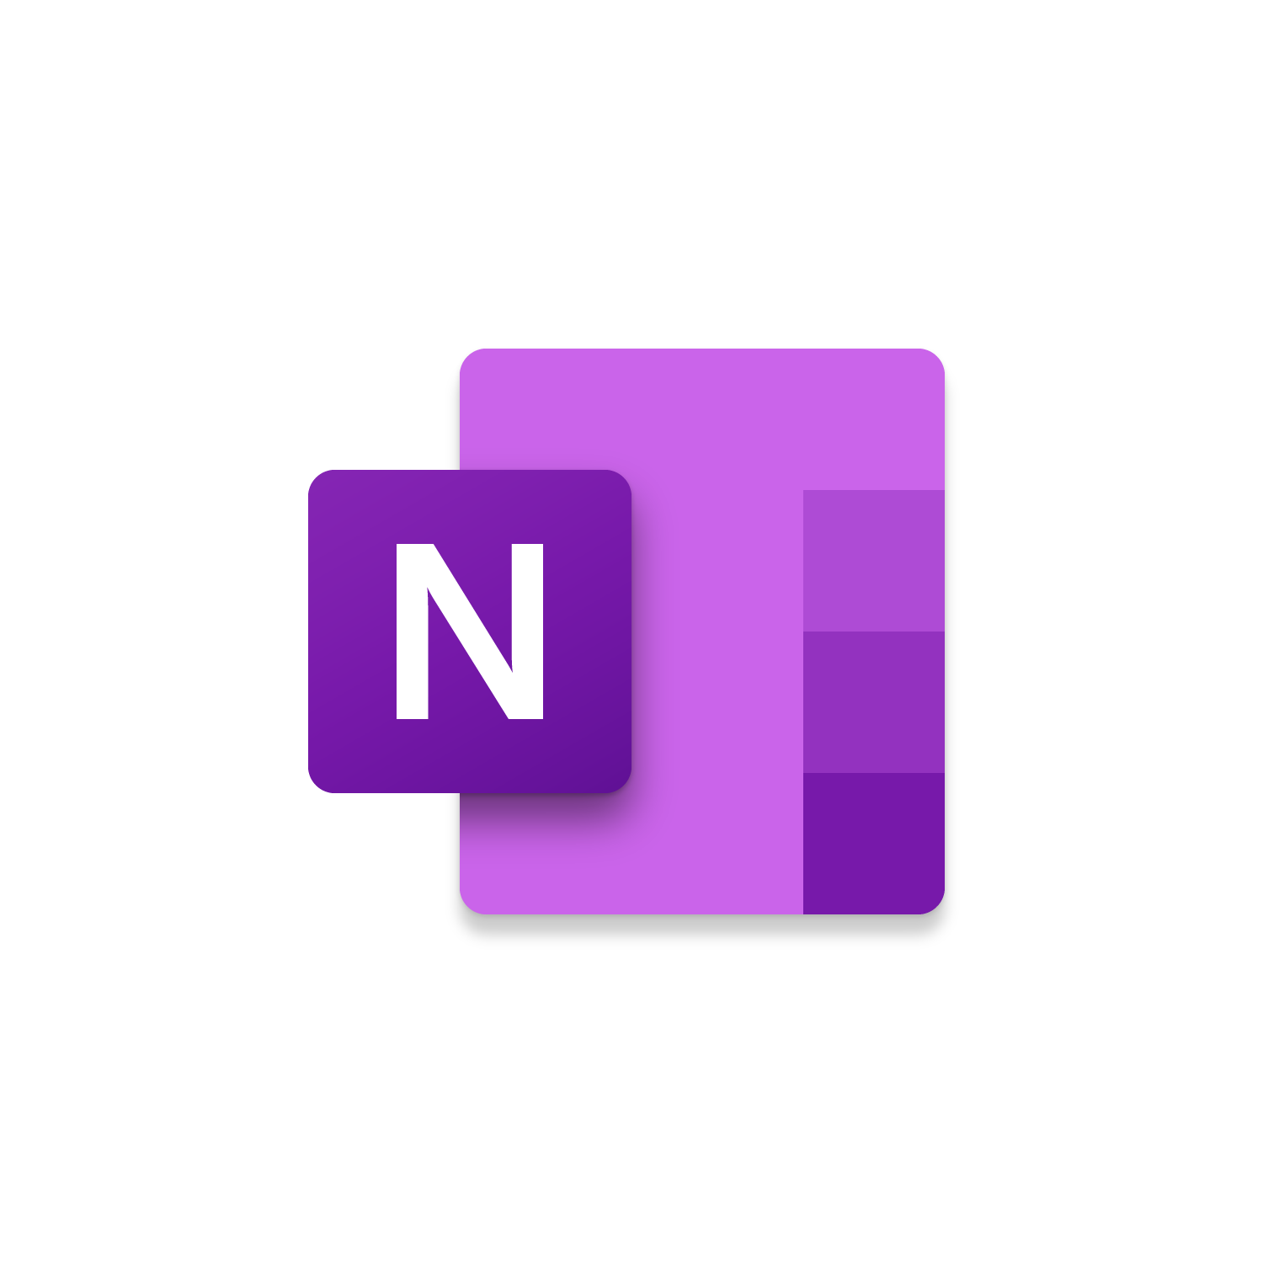
















Powering collaboration Across Microsoft 365
Membership service for Microsoft 365 teamwork apps
22+ Apps
Easy to share with your team
Partner ecosystem
Office 365 Groups
Centrally managed, secured, and governed
Azure Active Directory
Notes:
Huge thanks to our partners who build custom solutions for their customers leveraging Microsoft Graph APIs and PowerApps framework.
Groups are reused across 22 services: Calendar, Delve, Dynamics 365, Excel, Flow, Forms,
OneDrive for Business, OneNote, Outlook, People, Planner, Power BI, PowerApps, PowerPoint,
SharePoint Online, StaffHub, Stream, Sway, Microsoft Teams, Office 365 Video, Word and Yammer.

Slide 10






Office 365 Groups Visibility In Office Apps
Create
Outlook
Teams
Yammer
Office 365 Group created via Outlook is not visible in Teams
Default visibility for new group via SharePoint, Planner or Stream
Can be Team-ified
Office 365 Group created via Teams is not visible in Outlook
Can be exposed in Outlook using PowerShell
Office 365 Group created via Yammer is not visible in Outlook
Cannot be Team-ified as it is Yamm-ified ;-)
View
SharePoint
Stream
Planner
SharePoint
Stream
Planner
SharePoint
Stream
Planner
*SharePoint site collections – can be group-ified and are visible in Outlook by default
Notes:
We hide a Team from the other two apps, hide an Outlook group from Yammer etc. to avoid a comms breakdown because these are different comms modalities. For example, if there is a team of 10 people chatting in Teams, and the 11th one finds it is Outlook and sends an “excited to be part of the team” mail, the rest of the Team wouldn’t even see it if they primarily live in Teams. To avoid this, we hide it.

Slide 11
What we have delivered, new innovations & demos
Notes:
Quick show of hands – who here had attended the O365 Groups session last year?

Slide 12
End User Innovation

Slide 13
Demo
Groups Calendar on Outlook Mobile
Teams Mobile Member Management
SharePoint Group Card Member Search
Groups Hub
Outlook Desktop Actionable Email

Slide 14
End User Innovation
Last 12 Months Highlights
Member Management
Teamwork
Employee Engagement
Groups hub pending membership
Search for Group Members on the Group Card
Actionable emails for member approval on web/mobile
Microsoft Teams mobile member management
Multi-team support for FirstLine
Planner link to Groups Hub
Use Outlook Desktop to drag and drop emails to a Group Mailbox (move or copy)
Calendar entries can be owned by a Group Calendar and include selected invitees
Support for Group Calendar on iOS
Teams channel moderation
Receive personal copies of email sent to a Group Mailbox
SharePoint as a default files storage location
Deeper integration for Live Events leveraging Microsoft Stream
Create announcements in Teams channels
Notes:
Support for Question and Answer, rich text, and a new and improved user experience for Communities.

Slide 15
Admin Innovation

Slide 16

Office 365 Groups lifecycle & adoption
Self-service Provisioning
Fix policy violations like Ownerless Groups
05
Throttle
01
04
Policies: Expiration, Deletion & Retention
Rationalize redundant groups across apps
Office 365 Groups Lifecycle
Listen & Align
02
03
Report Monitoring
Productivity
Tenant-wide Rollout
Controlled Rollout
Identify key administration configurations
Assess Data Retention & Classification policies
Identify end-user trouble spots
Build end user education
Assess
Pilot
Controlled participation
Establish Group Governance Processes
Identify Graph APIs for custom flows
Exploration
Review Office 365 Groups concepts
Governance Discipline
Notes:
No matter where you are with your journey of using O365 Groups in your company (whether you’re exploring or piloting Groups), we provide with you with tools to reach a self-sustaining merry go round of O365 Groups Lifecycle that you see here in the top right, to help all employees in your company to be more productive at their work.

Slide 17
Office 365 Groups Tools to deploy at scale
Creation permissions
Naming policy
Expiration policy
Soft delete and restore
Upgrade DLs to groups in Outlook
Reporting
Policies and information protection
Access packages (Entitlement, Guests, etc)
“
…shadow IT is always a case of people trying to get their job done better/easier and usually occurs when they can’t get IT to support them effectively.
”
- CIO.com
Notes:
https://www.cio.com/article/3314738/shadow-it-the-cio-s-perspective.html
CIOs believe that embracing shadow IT is how IT departments go from the department of “no” to the department of “know.”
https://www.informationweek.com/strategic-cio/it-strategy/make-shadow-it-a-force-for-good/a/d-id/1332595
https://www.gartner.com/smarterwithgartner/make-the-best-of-shadow-it/

Slide 18
Empowering users with self-service
Limited to a subset of users
Creation is limited to certain business units/users
Progressively expand self-service during O365 apps onboarding
Guide users to collaboration choices
Common
Processes in place
Change management
Reporting & monitoring
Analytics
Enabled for all users
Everyone can create groups
Using teamwork apps to meet their diverse needs
Consistent classification and policy enforcement
Custom provisioning workflows
Notes:
You have two options:
Self-service for all users (recommended) – apply guardrails and allow users to create groups.
Limit creation to a specific set of users.
Both come with detailed reporting of Groups usage at your disposal.

Slide 19
Create Allow List of Users for Group Creation
#Create Security Group via Azure Portal
$GroupName = "Allowed To Create Groups"
#Allow users in the Security Group to create Office 365 Groups
$AllowGroupCreation = "False"
$settingsObjectID = (Get-AzureADDirectorySetting | Where-object -Property Displayname -Value "Group.Unified" -EQ).id
if(!$settingsObjectID){
$template = Get-AzureADDirectorySettingTemplate | Where-object {$_.displayname -eq "group.unified"}
$settingsCopy = $template.CreateDirectorySetting()
New-AzureADDirectorySetting -DirectorySetting $settingsCopy
$settingsObjectID = (Get-AzureADDirectorySetting | Where-object -Property Displayname -Value "Group.Unified" -EQ).id
}
$settingsCopy = Get-AzureADDirectorySetting -Id $settingsObjectID
$settingsCopy["EnableGroupCreation"] = $AllowGroupCreation
if($GroupName){
$settingsCopy["GroupCreationAllowedGroupId"] = (Get-AzureADGroup -SearchString $GroupName).objectid}
Set-AzureADDirectorySetting -Id $settingsObjectID -DirectorySetting $settingsCopy
Identify the set of user with permission to create a Group
Create a Security Groups with all these users
Configure users in this Security Group to have permission for Group creation
Notes:
Recommended for O365 Groups pilot

Slide 20
Demo
Entitlement Management
Groups Admin Role
SharePoint Site URL Rename
Microsoft Information Protection Labels

Slide 21
Expiration Policy
Groups lifecycle management on auto-pilot!

Slide 22
Group Lifecycle Management – A Balancing Act
Information Asymmetry
Administrators do not know which groups are actively used
Prevent Group Sprawl
Retain Group Knowledge
Notes:
Many of you gave us feedback that managing groups is like walking a tightrope. One one hand you want to conserve and retain institutional knowledge but on the other you want to prevent the sprawl of groups in your company leading to exhaustion of quotas. We have tools to help you with that!

Slide 23

Expiration Policy – Lifecycle management on auto-pilot!
Activity Based Expiration
User Activity
Megan edits a document in SharePoint
Contoso Marketing Office 365 Group
Group automatically renewed by one lifetime
Enrico visits a Teams channel
=
Auto-renewed!
Office 365 Group
Patty sends an email to an Outlook Group
Notes:
Call notification to work same way for inactive groups

Slide 24
Group expiration policy
Now GA!
Benefits
Auto-renewal of groups based on user activity New!
Expire inactive groups older than a specific period
Group owners get emails/ app notifications to take renewal action on the group
Can set expiration policy to specific groups
Expired groups can be restored within 30 days
Tips
Pilot with specific groups initially
Choose inactive groups based on the activity report in Microsoft Admin center
Review Audit Logs to see auto-renewed groups
Onboard your helpdesk team
Communicate renewal process to group owners
Ensure groups have multiple owners & configure alternate email for ownerless groups
Documentation: Office 365 Group Expiration Policy | Configure Office 365 groups expiration | Tech Community Blog
Notes:
Quick reminder: we are going to share slides

Slide 25
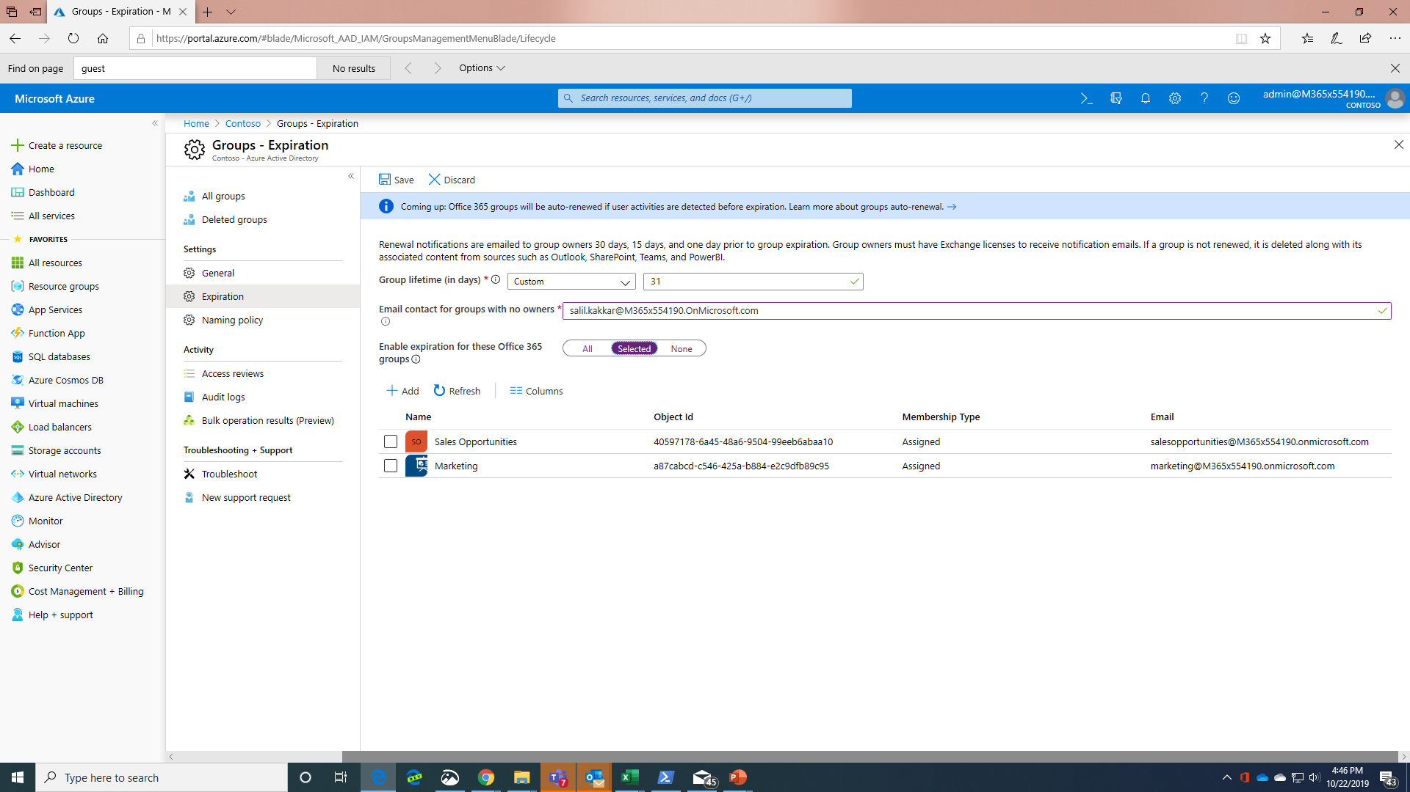

Slide 26
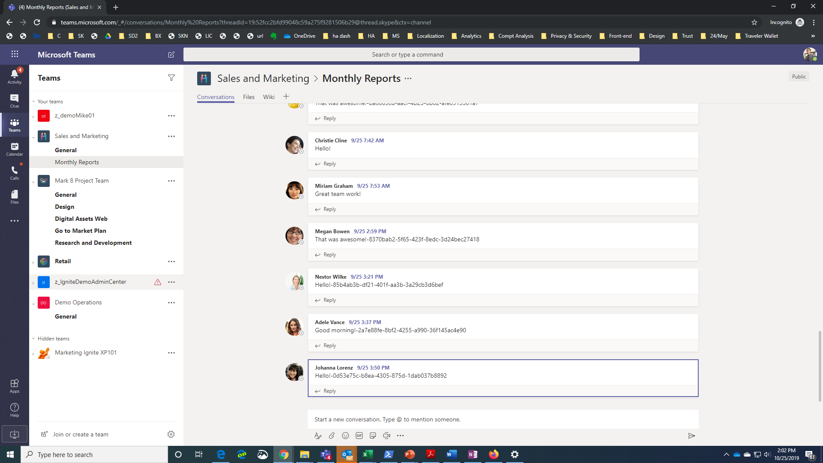

Slide 27
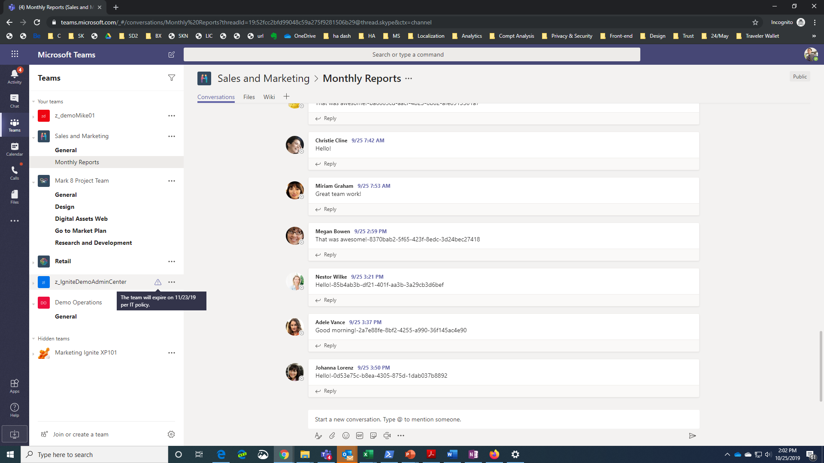

Slide 28
Group Reporting
Benefits
Shows activity across the Office 365 products in the organization
Includes group mailbox conversations, group site/files, membership (and guest count)
Enables trend analysis over the specified timeline
Leverage Power BI content packs for additional insights
Guidance
Monitor trends and review any usage anomalies
Review granular insight for each office app using specific activities
Monitor and reach out to group owners of active groups to learn uses cases and amplify them
Documentation: Office 365 Reports in the admin center | Office 365 Adoption content pack | Azure AD content pack

Slide 29
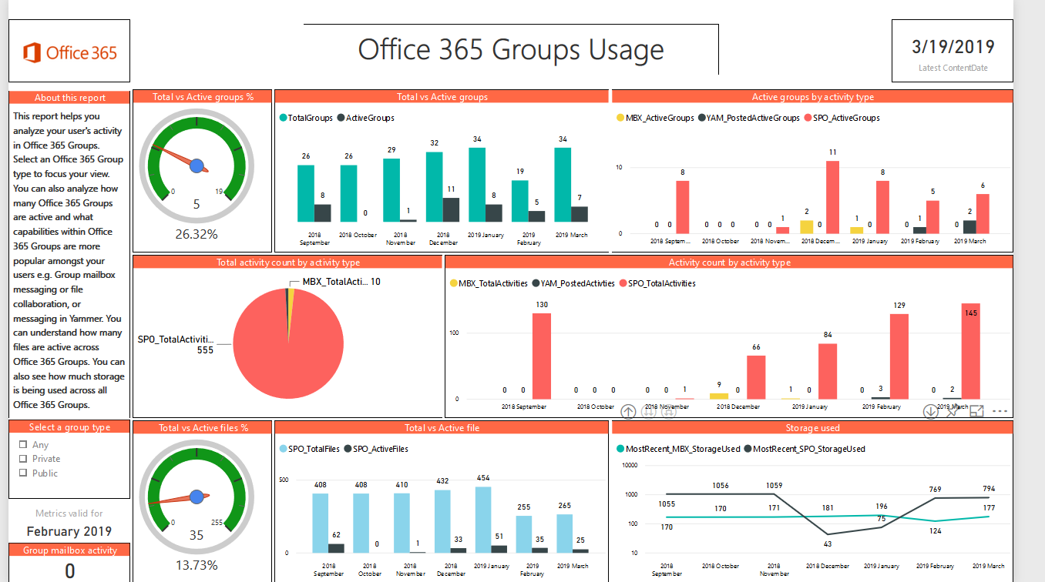
Sample Report

Slide 30
Admin Innovation
Last 12 Months Highlights
New Management Capabilities
Improved Admin Experiences
Managing at Scale
Naming policy generally available
Provide expiry notifications in the context of the app
Assign the Groups Administrator role to manage groups across the organization
Rename the SharePoint Site URL associated with an Office 365 Group
Improved Group management in Microsoft Admin Center
Browse and restore deleted groups
Quickly view which groups are enabled for Microsoft Teams
Modify properties as Global Admin without Exchange License assigned
Advanced filtering and sorting capabilities
Onboard users through Entitlement Management to quickly provide access to groups and apps
Define a unified set of Microsoft Information Protection labels which drive behavior across all groups
Automatically renew expiring groups based on group activity
Microsoft Graph updates for hideFromOutlookClients and hideFromAddressLists

Slide 31
Roadmap

Slide 32
Office 365 Groups roadmap
from Ignite 2018
Expiry: in-app expiry notification and auto-extend based on activity
New and improved group admin roles
Admin center improvements
Unified Group classification using Microsoft Information Protection Labels
(Public Preview)
Teams: dynamic membership support, manage Teams page
Group driven membership

Slide 33
Office 365 Groups roadmap
Office 365 Groups classification using Microsoft Information Protection Labels (General Availability)
Expanded capabilities for Groups Administrator role
Additional Microsoft Admin Center enhancements
Improvements to Dynamic Groups at scale
Information Barrier support for Office 365 Groups
Native Mode for Yammer
Group driven membership
Share messages between Outlook and Teams

Slide 34
Closing

Slide 35

Create a governance plan https://aka.ms/GroupsGP Enable self-service https://aka.ms/GroupsSS Engage FastTrack https://microsoft.com/FastTrack Enable analytics to understand usage https://aka.ms/UsageAnalytics Connect with community https://aka.ms/M365TC Check out our blog https://aka.ms/M365TCBlog
Call to Action

Slide 36

FastTrack Your advisor to help deploy Microsoft 365
Visit our FastTrack booth
Onboard to Microsoft 365 services and migrate your data​
Configure identity and security capabilities ​
New! Guide Windows 10 deployment ​
Deliver app compat services​
Deploy chat-based collaboration and productivity apps​
Gain customer user adoption and realize business value​
Delivered by Microsoft or approved partners​
Included in your eligible subscription at no additional cost​
www.Microsoft.com/FastTrack
Notes:
Slide objective: Overview of FastTrack for Microsoft 365
FastTrack for Microsoft 365 helps organizations decrease time-to-value when deploying cloud solutions. Specifically, FastTrack can help customers:
Migrate email and content, and onboard to Microsoft 365 services. We’ll enable customers to quickly deploy new cloud capabilities with Microsoft 365, including assessment and remediation guidance to help prep their infrastructure for the cloud.
Enable identity, device management, and modern security. Deliver the value of the Microsoft 365 security and management stack to their organization.
Last year, we introduced an application compatibility service and this year, we’ve added Windows 10 deployment service to help customers move off of Windows 7 and onto Windows 10.
Deploy chat-based collaboration with Microsoft Teams and productivity apps with Office ProPlus.
Gain user adoption and realize business value.
FastTrack is an ongoing and repeatable benefit delivered by Microsoft engineers and approved partners to help customers deploy and adopt Microsoft 365 cloud services at their own pace. FastTrack is included in their eligible subscription at no additional cost.
All customers can log in to the FastTrack online portal to access planning resources and training assets with an Azure AD account. Many resources do not require a login at all.
150+: Customers with 150+ seats have access to FastTrack specialists to support their Microsoft 365 cloud deployment and adoption.
500+: For customers with 500+ seats, FastTrack will perform your data/email migration for you, freeing up time to allow you to deploy more products at one time.
And, FastTrack will integrate with partners and work together to ensure a successful project. If you don’t have a partner, we can refer you to one for additional services.

Slide 37
Next steps
Create a plan to enable self-service with governance
Drive Teamwork app usage with FastTrack resources
Submit session evaluations ☺
Key resources
Documentation | aka.ms/O365g
Questions | aka.ms/O365ng
User voice | aka.ms/O365uv
FastTrack | fasttrack.microsoft.com/office
Microsoft Graph | aka.ms/O365GGraph
Roadmap | office.com/roadmap
Governance Toolkit | github.com/martinagrom
Thank you!
Mike McLean
Principal Program Manager
Office 365 Groups
mmclean@Microsoft.com | @ @mikemcleanlive

Slide 38
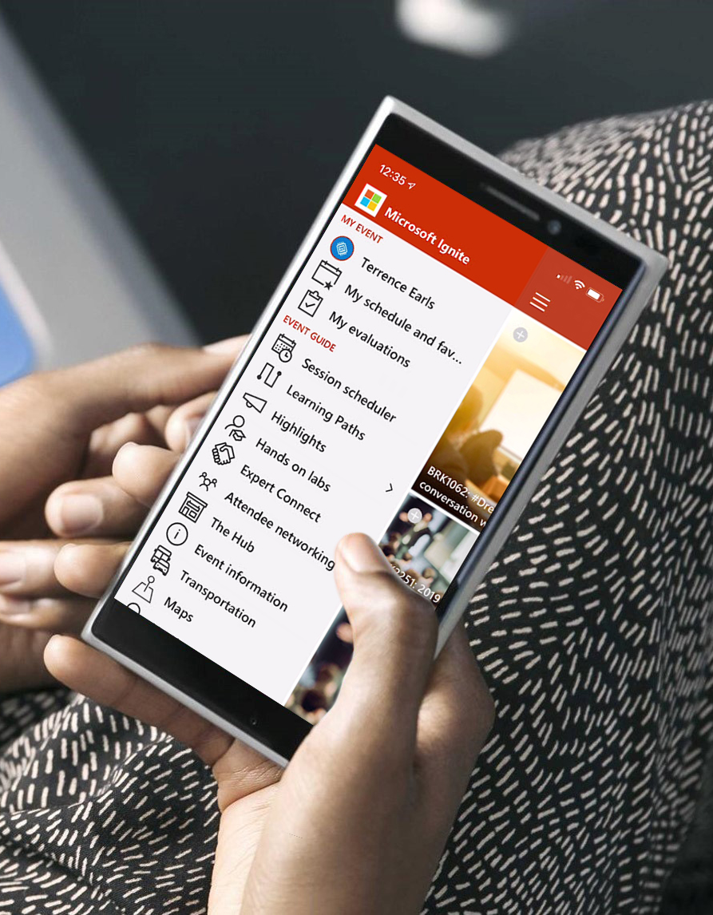
Please evaluate this session Your feedback is important to us!

Slide 39
Appendix

Slide 40
Group Calendar Select Invitees

Slide 41
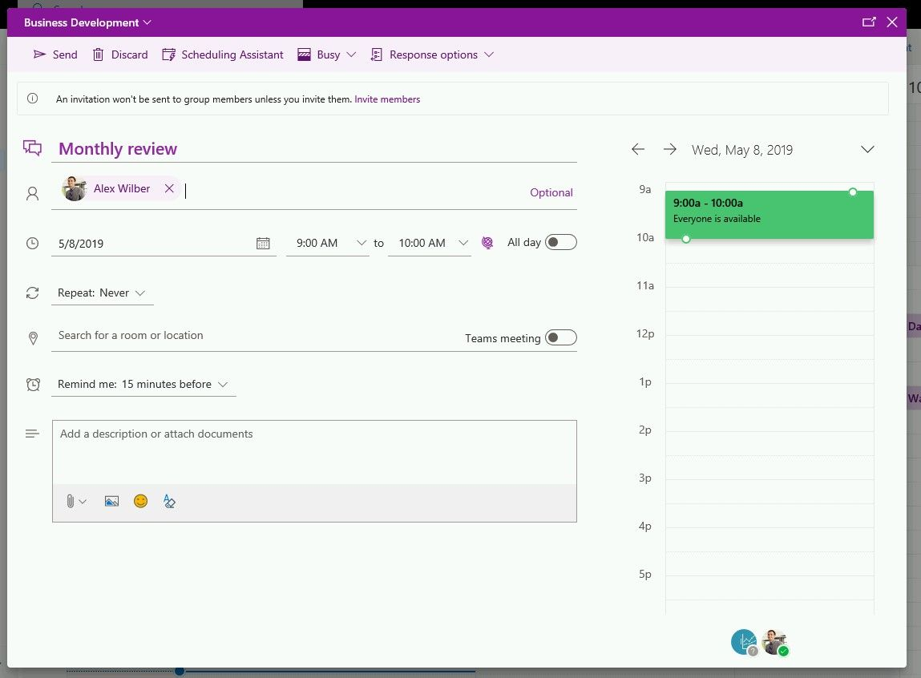
Selectively invite people to Group Meetings
This update enables you to:
Put something on a shared group calendar
Pick whomever you want to invite, which may not be the group itself.
"Brownbag-style events": A lunchtime learning session is typically not mandatory for attendees, but is required for the organizer and the presenter.
Now, you can create an event on the group calendar and add specific individuals without adding the group itself to the attendees list, and hence not blocking every member’s calendar.
https://techcommunity.microsoft.com/t5/Office-365-Groups/Invite-who-you-want-in-group-calendars/m-p/522143

Slide 42
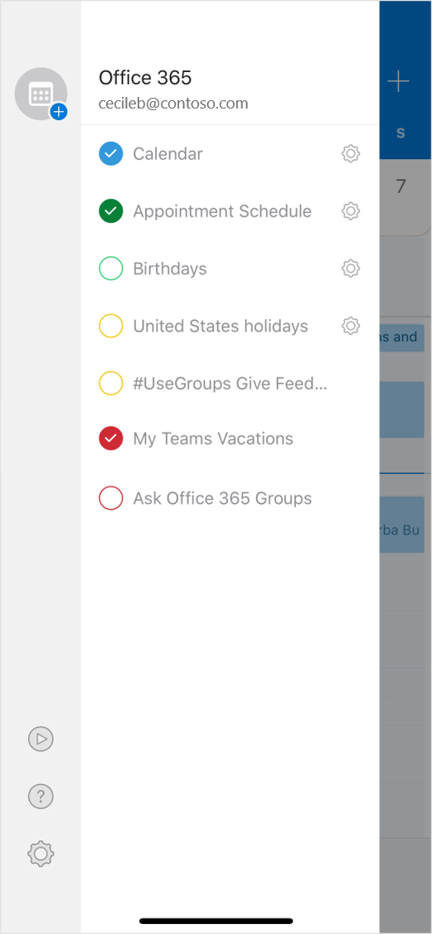
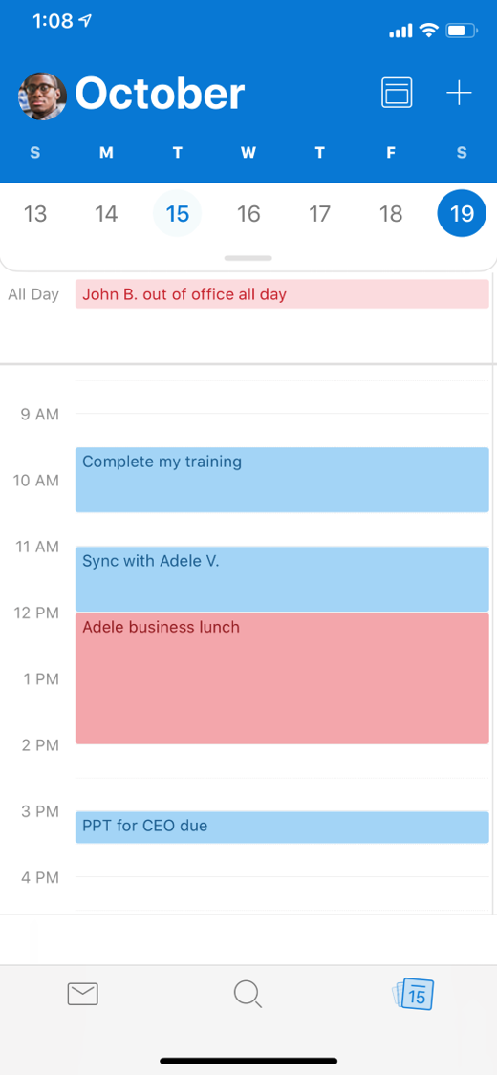
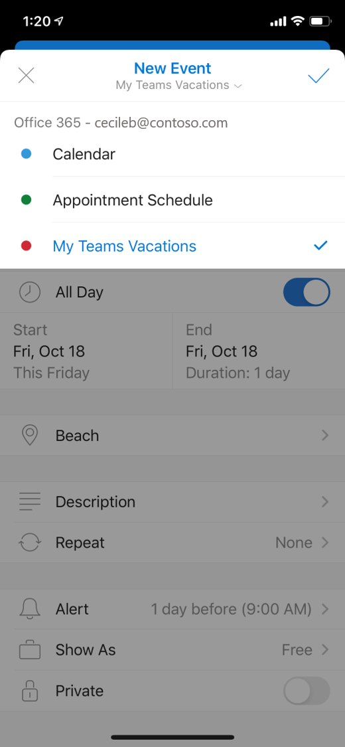
Groups Calendar now on Outlook Mobile
Available now!
View Group Calendar
Create Group Events

Slide 43
Entitlement Management

Slide 44
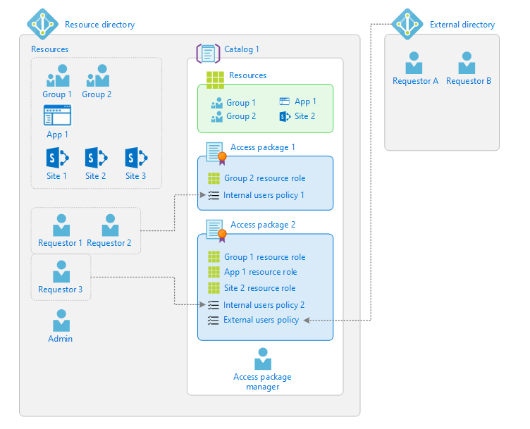
Entitlement Management
a
Notes:
Entitlement Management allows you as an IT Admin to create access packages that consists of a predefined set of groups, and when a new user joins your organization you can send them a link to this access package, and when they click this link they will be added to all the groups which are a part of this access package. The users would not need to find groups to join by themselves and it makes their onboarding in the company fast and easy.

Slide 45
Entitlement Management
Benefits
Enables management for groups access, applications and SPO for internal and external users
Access is available only for the time access is required
Based on Azure Active Directory
Tips
Create access packages for related resources users can request access to
Define rules for how to request resources and when access expires
Govern the lifecycle of access
Delegate management of resources
Documentation: Entitlement Management | Access Packages
Notes:
Employees in organizations need access to various groups, applications, and sites to perform their job. Managing this access is challenging. In most cases, there is no organized list of all the resources a user needs for a project. The project manager has a good understanding of the resources needed, the individuals involved, and how long the project will last. However, the project manager typically does not have permissions to approve or grant access to others. This scenario gets more complicated when you try to work with external individuals or companies.
Azure Active Directory (Azure AD) entitlement management can help you manage access to groups, applications, and SharePoint Online sites for internal users and also users outside your organization.

Slide 46
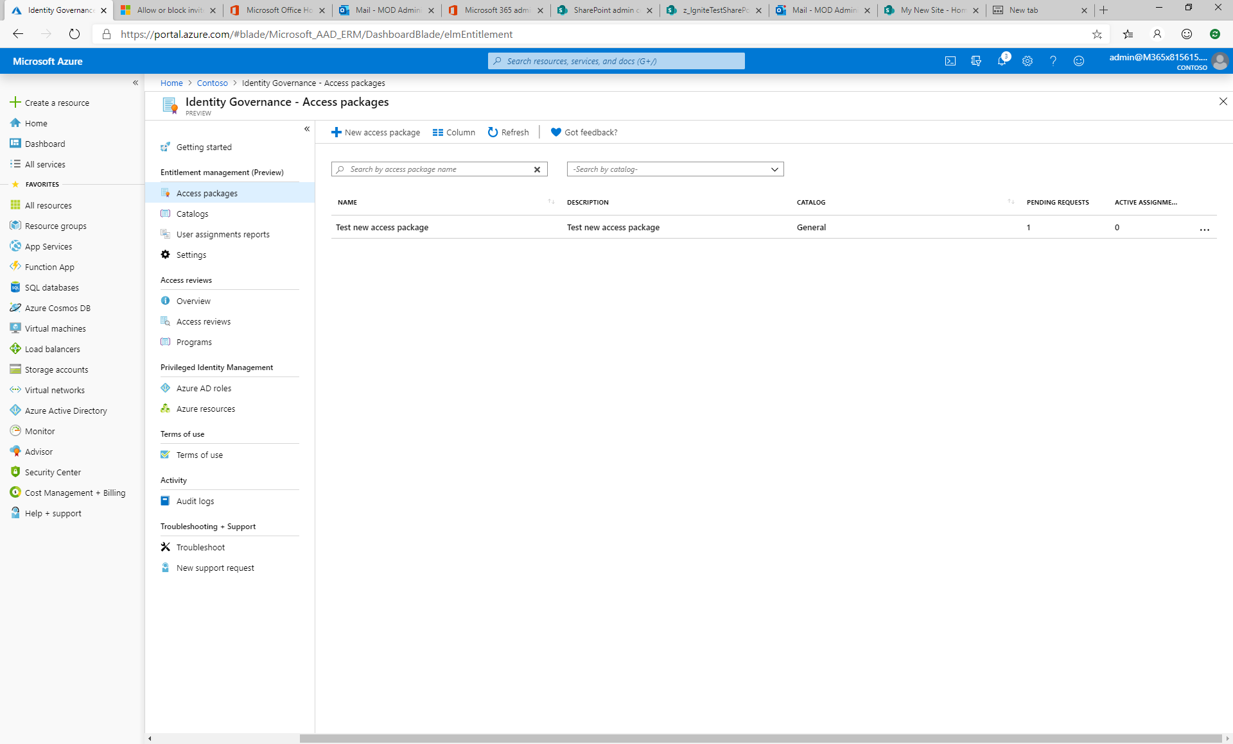

Slide 47
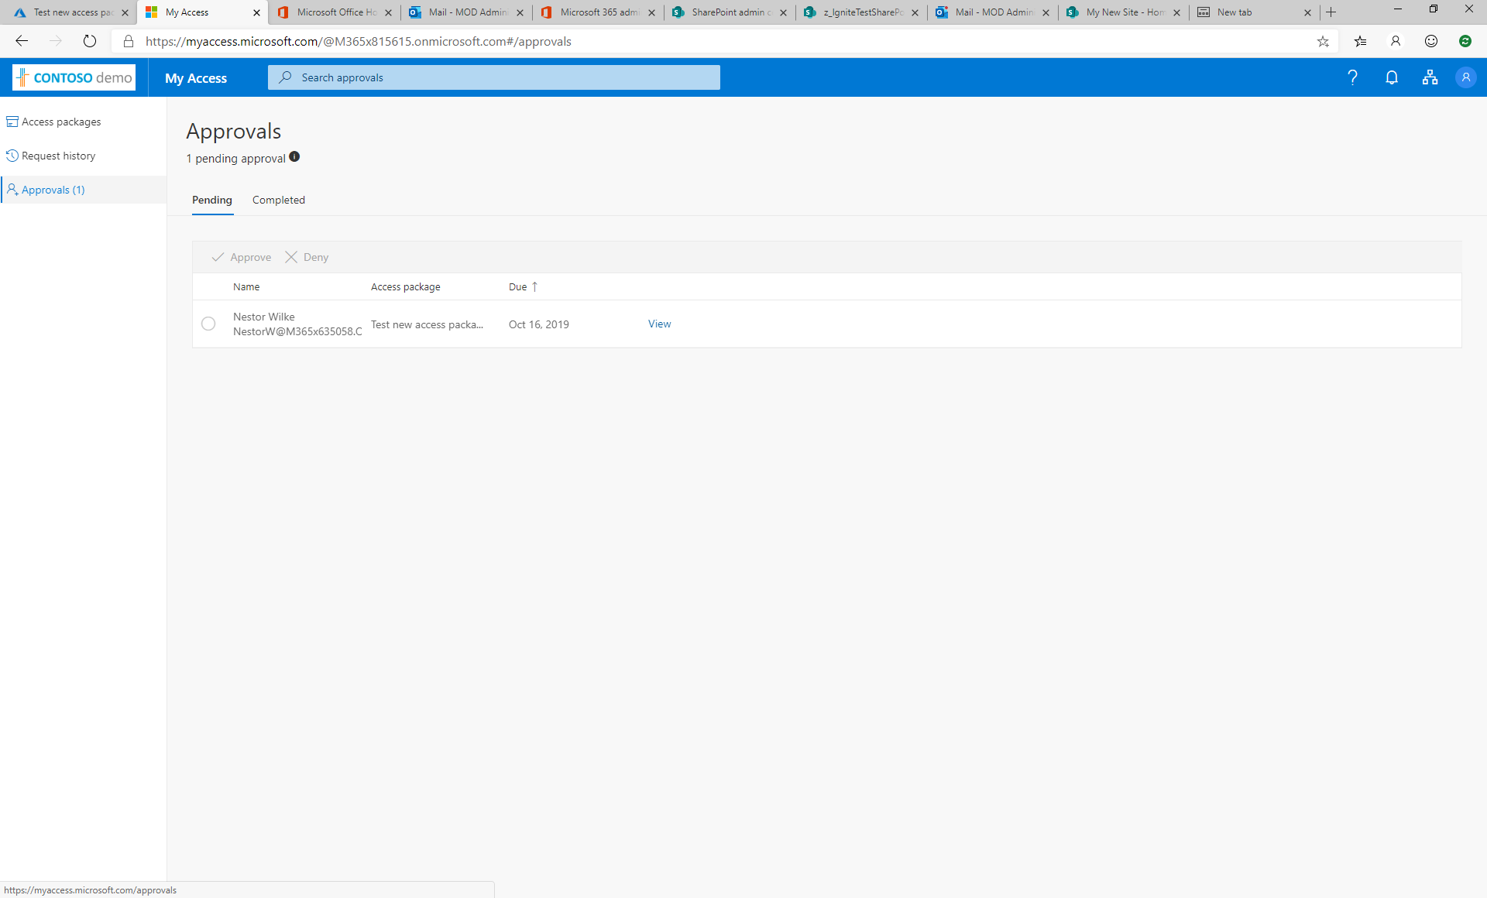

Slide 48
Groups Admin Role

Slide 49
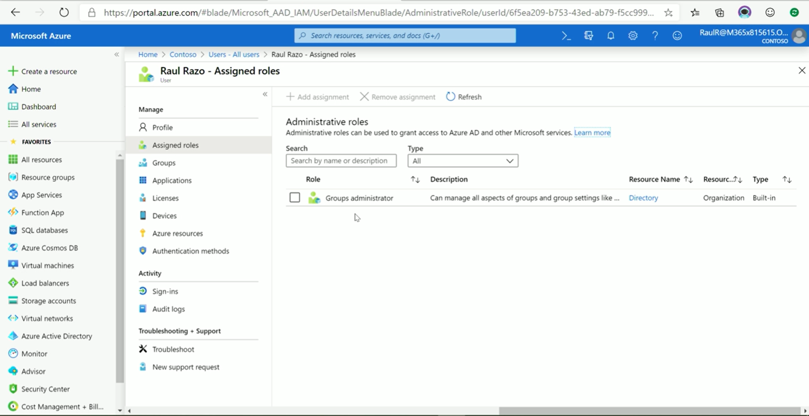
Notes:
We are now introducing a Groups Administrator role. This person does not have all the privileges of a global administrator but is limited to O365 groups administration. This role has the rights to set all Groups related policies such as Naming Policy and Expiration Policy as well as add/remove members or promote to owners. This role extends to security groups as well.

Slide 50
Groups Admin role
Now GA!
Benefits
Enroll a larger helpdesk team for Groups management
Ability to manage both Groups and Policies
Doesn’t require any other high-privilege roles
Use in the Microsoft 365 admin center, the Azure Portal and via cmdlets
Guidance
Limit to a small subset of extended admins
Delegate restore tasks to end-users though Groups Hub

Slide 51
Microsoft Admin Center Enhancements

Slide 52
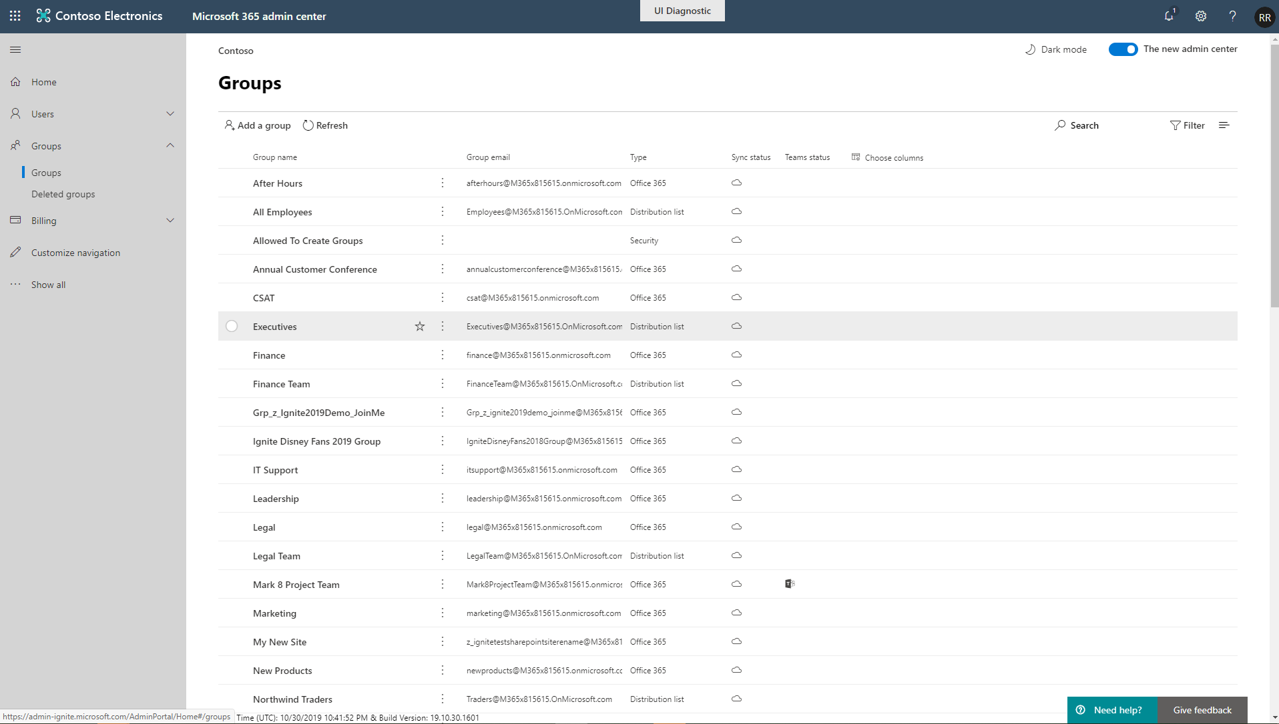
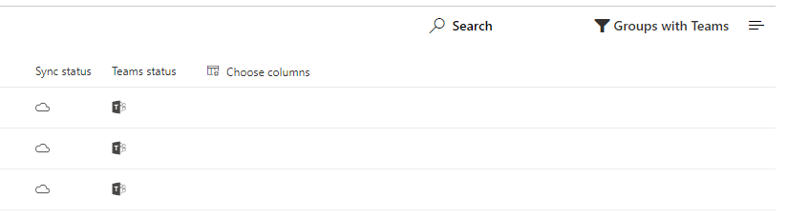
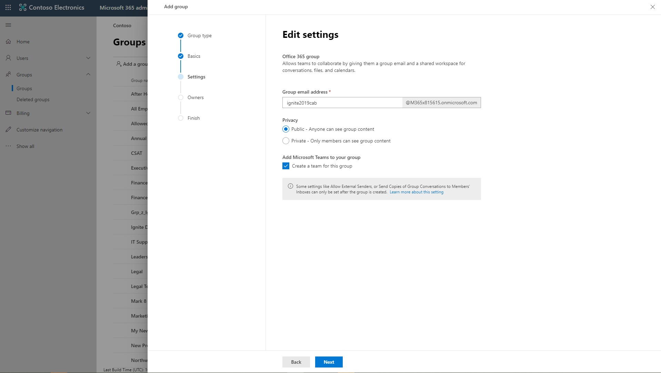
Microsoft Admin Center Enhancements
Updated user experience
New Group creation wizard
Browse and restore deleted groups
Advanced sorting/filtering
Modify Exchange properties without requiring an Exchange license
Quickly view Groups enabled for Microsoft Teams

Slide 53
Microsoft Information Protection Labels

Slide 54
Microsoft Information Protection Labels for Groups
Benefits
Labels helps you classify data across your organization
Automatically enforce policies based on labels
Restrict who can create public, external and other high privilege groups
Guidance
Sign up for the public preview, launching end of Nov’19
Pilot with a single department, start with new labels and simple policy assignment
Educate user to think about classification first instead of public/private
Single set of labels across documents, emails and groups
Documentation: Group settings | Overview of retention policies | Overview of labels | Search the audit log

Slide 55
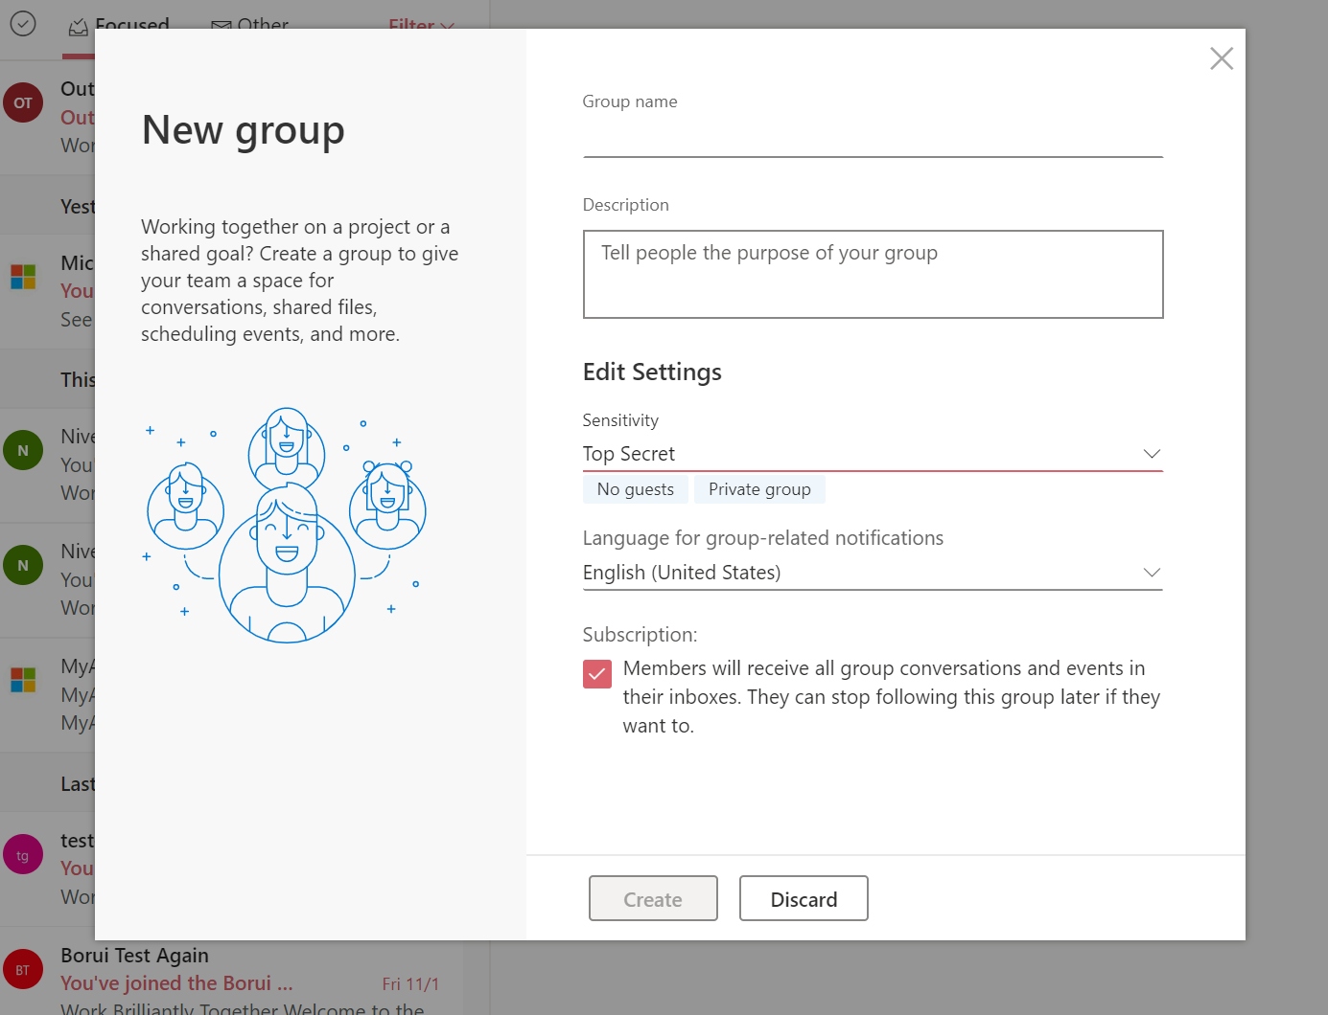
Microsoft Information Protection Labels for Groups

Slide 56
SharePoint Site URL Rename

Slide 57
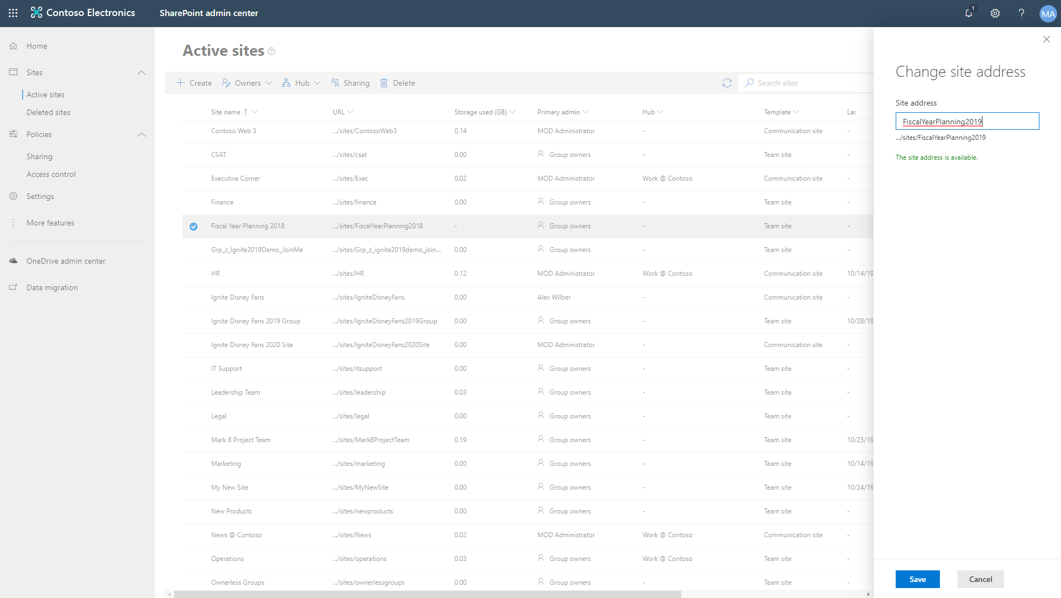
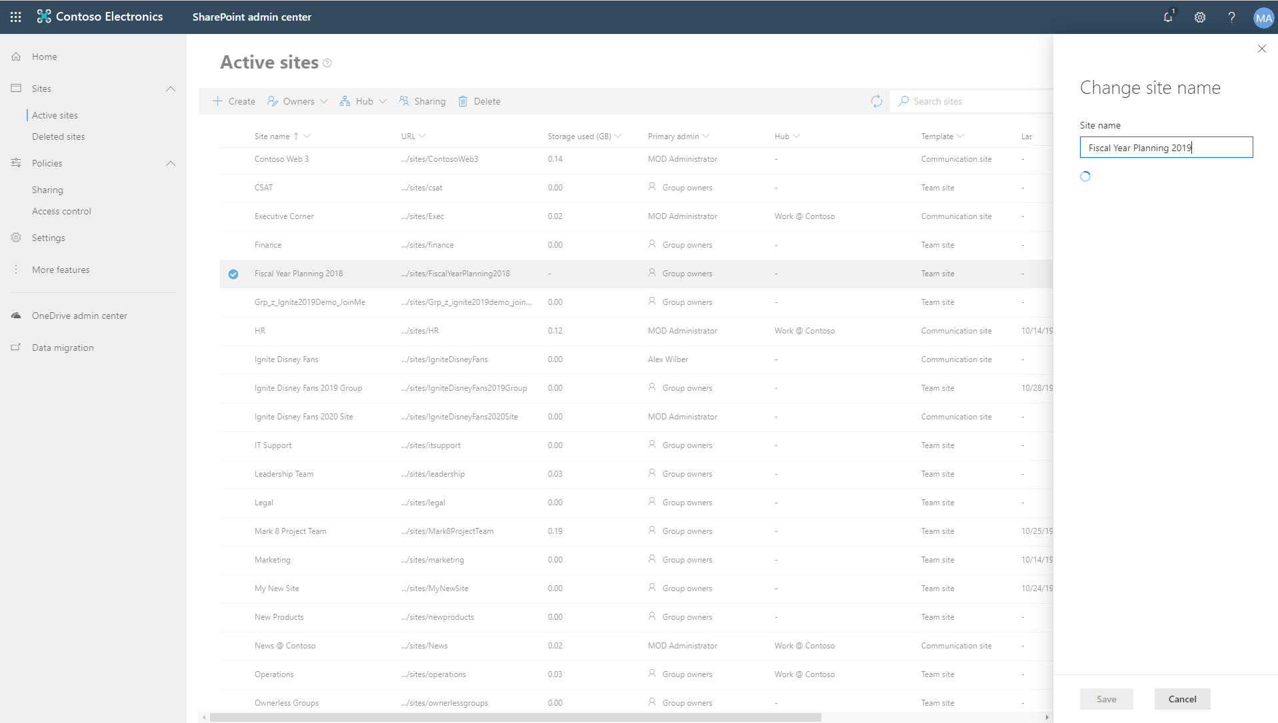
SharePoint Site URL Rename
Change the URL for Office 365 group-connected team sites, modern team sites not connected, Communication sites, and Classic team sites
Permissions, sharing links, synced locations, and recent lists in Office apps (MRU) updated
Users won't be able to view the team's files within the Teams app, but access them from Teams by selecting Open in SharePoint
Re-associate Hub Sites, InfoPath forms, and SharePoint workflow 2013, etc
Documentation: https://aka.ms/siterename

Slide 58
Naming Policy
Manage groups display name on create or change
Implement blocked words

Slide 59
Group naming policy
Benefits
Applies to all O365 apps
Ensure group names follow your organization schema
Use fixed strings or Active Directory attributes as prefixes and/or suffixes
Define custom blocked words
Now GA!
Tips
Use short strings as suffix
Use attributes with values
Don’t be too creative, total name length has a maximum of 264 characters
Documentation: Office 365 Groups Naming Policy

Slide 60
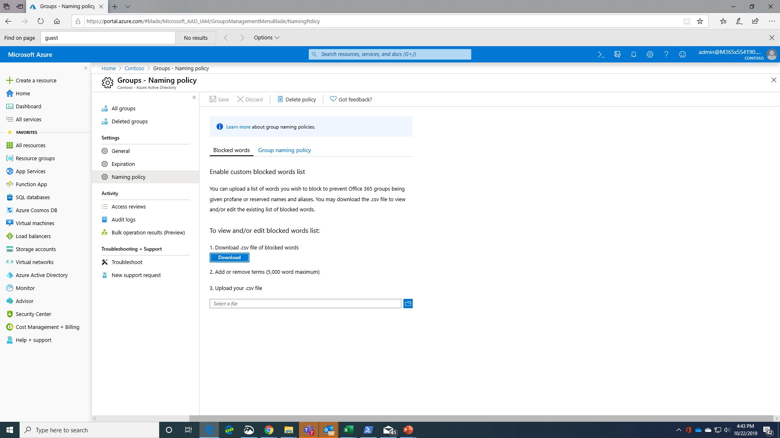

Slide 61
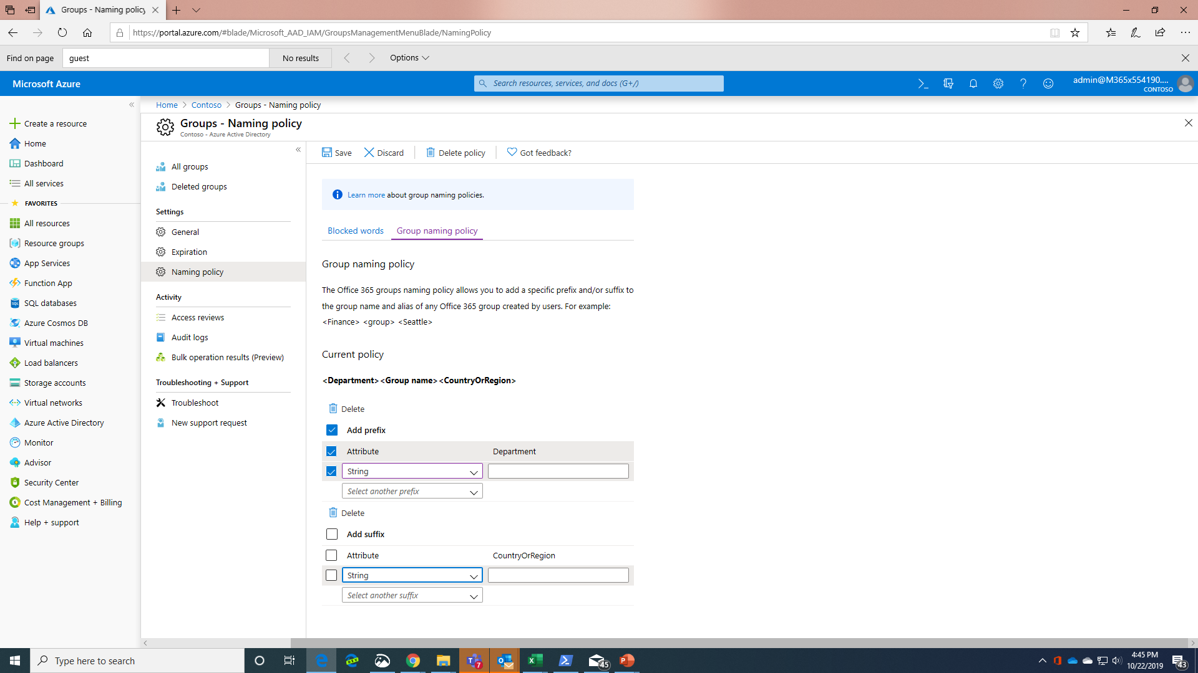

Slide 62
How does Microsoft manage Office 365 Groups?

Slide 63
How Microsoft manages groups Empower employees while protecting content, keeping compliant, and holding employees accountable
Process driven group creation and life-cycle
Creation tied to Dynamic Group of all full-time employees; non-employees can’t create groups
No naming prefix/suffix but blocked words
Usage guidelines shown with plain language (e.g., “Be polite & inclusive”)
180-day group life cycle; groups must be renewed or will be deleted (unless under retention) (expiry policy)
Custom job emails group members for groups with no owner
Empower employees
Ensure accountability
Classification, protection & compliance
Collection configured in Azure AD; Highly Confidential, Confidential (default), General
Custom jobs set Privacy to Private and disable external membership/sharing based on classification. Limiting reach based on classification.
Group site provisioned in region tied to user’s Preferred Data Location (multi-geo)
Divisional groups created in SharePoint have retention configured with site template
Template model also used to change sharing settings on divisional groups.
Custom jobs to enforce ownership policy (2 owners, including at least 1 full-time employee)
Membership reviews for groups with external members (access reviews)
Identify valuable content
Protect assets
Notes:
David Johnson for update?

Slide 64
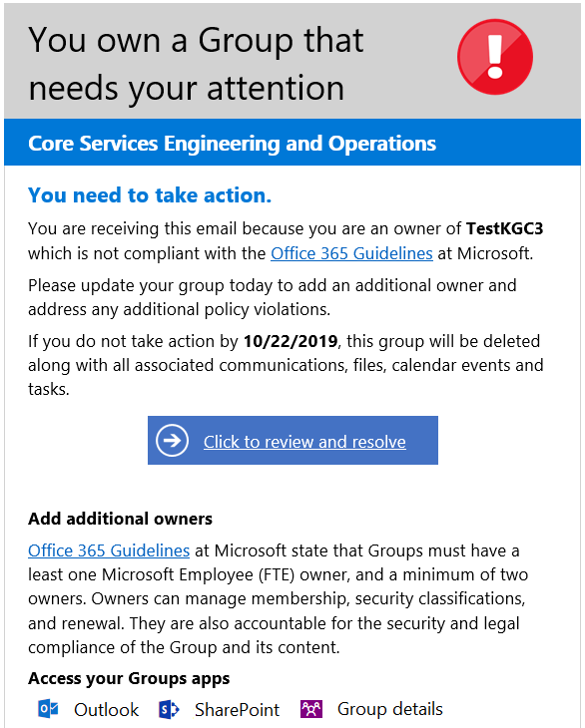
Custom policies
Orphan groups
Minimum Ownership
Minimum FTE Ownership
Mandatory Classification
Classic and Communication sites governance
Limit reach based on classification
Privacy based on classification (in product soon)
External membership and sharing disablement based on classification (in product soon)

Slide 65
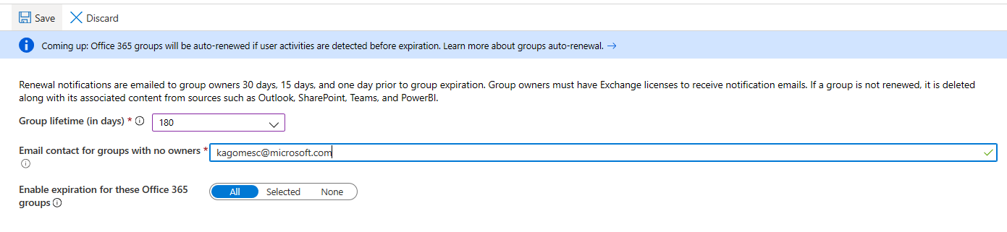
Lifecycle Management
Enable in-product Lifecycle Management
Microsoft enforces 180 days Lifecyle
A phased approach was adopted to deploy this policy; we started with cycles of 360 days and progressively reduced the window.
What you can define when setting Expiration Policies
Set expiration timeline
Notification intervals are set automatically
Set fallback email address for ownerless groups
Apply policy to selected groups
Soon groups will be auto-renewed based on membership activity (in Private Preview).
Notes:
Slide objective
Show how the IT admin can easily set up an expiration policy in Azure AD.
Talking points
You configure expiration policy using a simple UI in Azure AD. This defines the life cycle of groups, which sites within the group inherit. Group owners are automatically notified of a pending group expiration.
Speaker notes
How do we manage group and site life cycle? We configure Azure AD to define the life cycle of groups. Sites inherit this configuration from the group. In Microsoft, we have a 180-day life cycle. At the 180-day point, a group needs to be renewed, or it automatically expires. IT can configure an email address that so that in the event there's no group owner, IT is notified of a pending expiration.

Slide 66
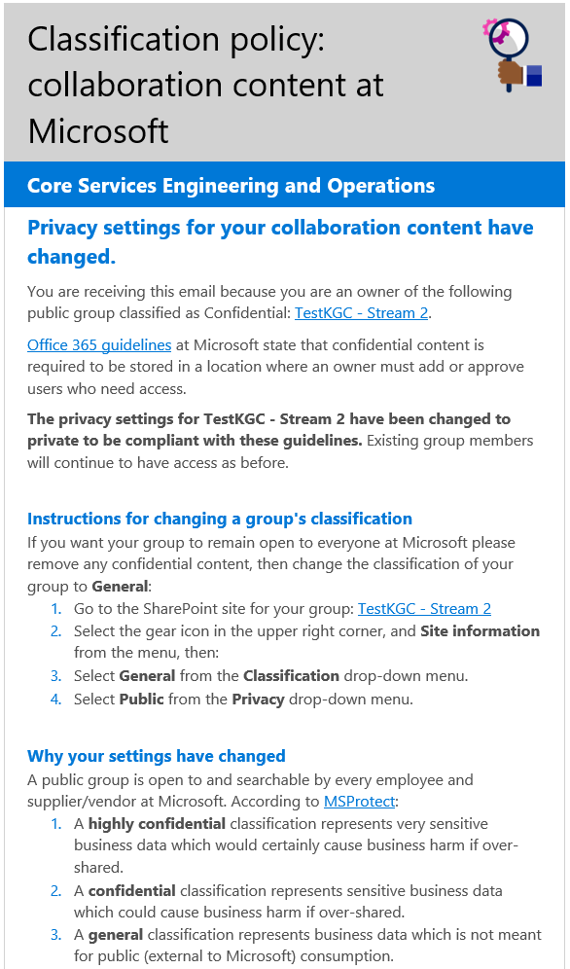
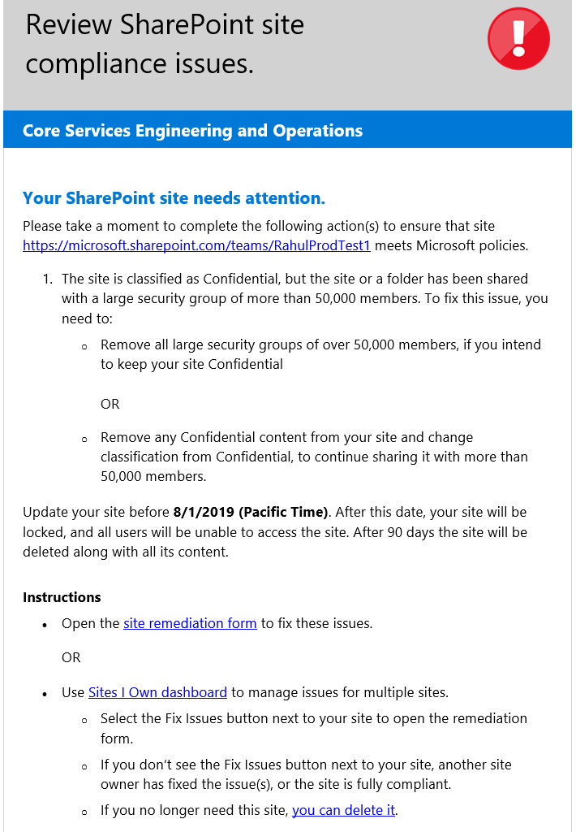
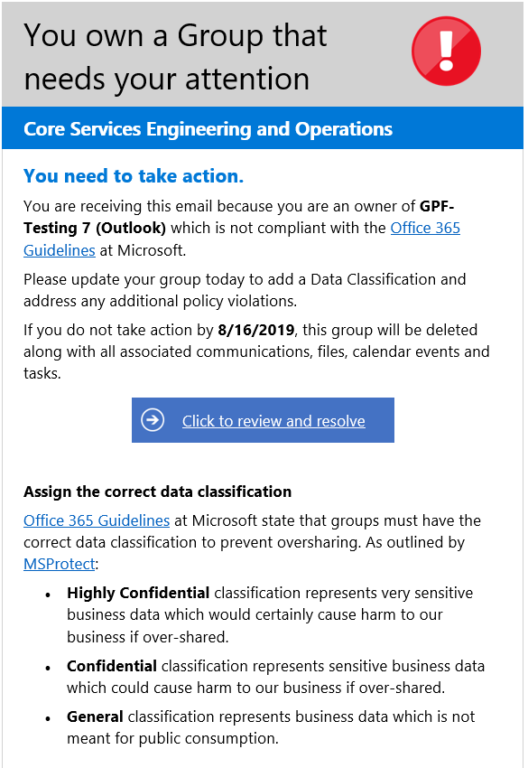
Custom policies
Minimum Ownership
Privacy based on classification
Control exposure using processes and limits
Mandatory Classification

